Slide 1

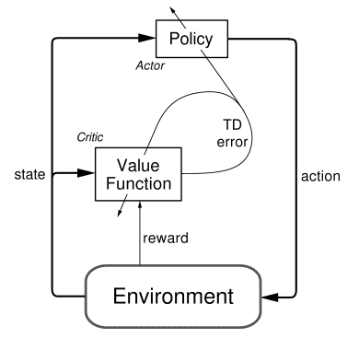




Example
pendulum
Problem
Pendulum Problem(진자운동)
State : {$\sin{θ}$ , $\cos{θ}$, $\dot{θ}$}
* Max_speed = 8
[1 X 3] matrix
Action : {$torque$}
[1 X 1] matrix
${θ}$
Reward : $θ,\dot{ θ}$가 작을 수록 Action이 작을수록 높은 Score
$$\dot{θ}$$
Actor-Critic + DQN → DDPG(Deep Deterministic Policy Gradient)
Actor(Policy_Gradient)
Replay buffer :
샘플간 상관관계를 줄여준다.
Target Q net:
Update시 target을 안정적으로 만든다.
+
Critic(Q - Approximate)

Slide 2
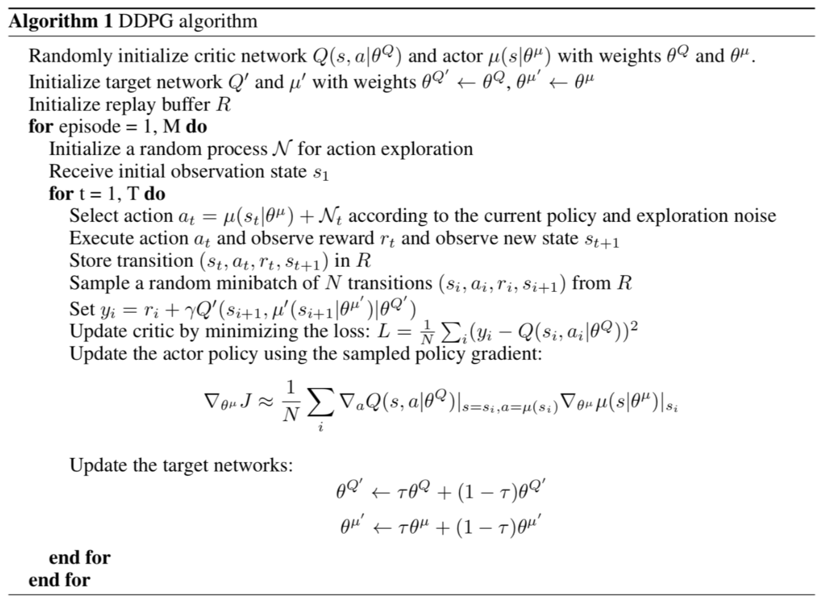
Example
pendulum
Problem
Actor-Critic + DQN → DDPG(Deep Deterministic Policy Gradient)

Slide 3
Example
pendulum
Problem
Tensorflow → 각 레이어마다 다른 이름의 파라미터를 만들어 줘야 하고
각 네트워크마다 Session을 열고 닫고 를 반복함으로 코드에 복잡성이 올라감
(Define – and –Run)(Static graph)
즉, 모델을 만들고 값을 다 따로 넣어 줘야함)
Pytorch → 각 네트워크 레이어를 하나의 파라미터로 합칠 수 있고,
(Define – by –run)(Dynamic graph)
즉, 모델을 만들어 바로 적용할 수 있어서 직관적인 코딩이 가능하다.)

Slide 4
Example
pendulum
Problem
1. ReplayBuffer() 선언
class ReplayBuffer(): def __init__(self): self.buffer = collections.deque(maxlen=buffer_limit) def put(self, transition): self.buffer.append(transition) def sample(self, n): mini_batch = random.sample(self.buffer, n) s_lst, a_lst, r_lst, s_prime_lst, done_mask_lst = [], [], [], [], [] for transition in mini_batch: s, a, r, s_prime, done_mask = transition s_lst.append(s) a_lst.append([a]) r_lst.append([r]) s_prime_lst.append(s_prime) done_mask_lst.append([done_mask]) return torch.tensor(s_lst, dtype=torch.float), torch.tensor(a_lst), \ torch.tensor(r_lst), torch.tensor(s_prime_lst, dtype=torch.float), \ torch.tensor(done_mask_lst) def size(self): return len(self.buffer)

Slide 5
Example
pendulum
Problem
2. $μ 파$라미터와 , Q 파라미터 생성
class MuNet(nn.Module): def __init__(self): super(MuNet, self).__init__() self.fc1 = nn.Linear(3, 128) self.fc2 = nn.Linear(128, 64) self.fc_mu = nn.Linear(64, 1) def forward(self, x): x = F.relu(self.fc1(x)) x = F.relu(self.fc2(x)) mu = torch.tanh(self.fc_mu(x)) * 2 # Multipled by 2 because the action space of the Pendulum-v0 is [-2,2] return mu
class QNet(nn.Module): def __init__(self): super(QNet, self).__init__() self.fc_s = nn.Linear(3, 64) self.fc_a = nn.Linear(1, 64) self.fc_q = nn.Linear(128, 32) self.fc_3 = nn.Linear(32, 1) def forward(self, x, a): h1 = F.relu(self.fc_s(x)) h2 = F.relu(self.fc_a(a)) cat = torch.cat([h1, h2], dim=1) q = F.relu(self.fc_q(cat)) q = self.fc_3(q) return q

Slide 6
Example
pendulum
Problem
3. 학습함수 행성
def train(mu, mu_target, q, q_target, memory, q_optimizer, mu_optimizer): s, a, r, s_prime, done_mask = memory.sample(batch_size) target = r + gamma * q_target(s_prime, mu_target(s_prime)) q_loss = F.smooth_l1_loss(q(s, a), target.detach()) q_optimizer.zero_grad() q_loss.backward() q_optimizer.step() mu_loss = -q(s, mu(s)).mean() # That's all for the policy loss. mu_optimizer.zero_grad() mu_loss.backward() mu_optimizer.step()

Slide 7
Example
pendulum
Problem
4. 네트워크 분리
def soft_update(net, net_target): for param_target, param in zip(net_target.parameters(), net.parameters()): param_target.data.copy_(param_target.data * (1.0 - tau) + param.data * tau)
5. 메인함수
def main(): env = gym.make('Pendulum-v0') memory = ReplayBuffer() rAll = [] x_lavel = [] q, q_target = QNet(), QNet() q_target.load_state_dict(q.state_dict()) mu, mu_target = MuNet(), MuNet() mu_target.load_state_dict(mu.state_dict()) score = 0.0 print_interval = 20 reward = -2000.0 mu_optimizer = optim.Adam(mu.parameters(), lr=lr_mu) q_optimizer = optim.Adam(q.parameters(), lr=lr_q) ou_noise = OrnsteinUhlenbeckNoise(mu=np.zeros(1))

Slide 8
Example
pendulum
Problem
5-1. 메인함수
for n_epi in range(1000): s = env.reset() for t in range(300): # maximum length of episode is 200 for Pendulum-v0 a = mu(torch.from_numpy(s).float()) a = a.item() + ou_noise()[0] if n_epi // 100 == 5: env.render() s_prime, r, done, info = env.step([a]) memory.put((s, a, r / 100.0, s_prime, done)) score += r s = s_prime if done: break if memory.size() > 2000: for i in range(10): train(mu, mu_target, q, q_target, memory, q_optimizer, mu_optimizer) soft_update(mu, mu_target) soft_update(q, q_target) if n_epi % print_interval == 0 and n_epi != 0: print("# of episode :{}, avg score : {:.1f}".format(n_epi, score / print_interval)) rAll.append((score / print_interval)) reward = (score / print_interval) score = 0.0

Slide 9



Example
pendulum
Problem
Episode : 0 ~ 10
Score: -1500~-1400
Episode : 550~560
Score: -600
Episode : 990~999
Score: -145

Slide 10
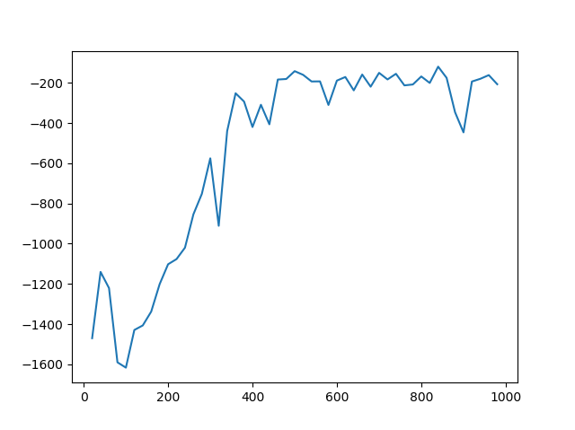
Example
pendulum
Problem
Score
episode

